Slide 1

Title
Cloud-Based Food Donation & Distribution System
Supervisor
Dr. K. Santhiya Lakshmi
Saveetha School of Engineering
Students Name
M. Gopi Krishna Reddy 192372055
M. Ranjith Kumar Reddy 192524172
M. Praneeth 192324184
K. Mothish 192321057
1

Slide 2
INTRODUCTION
Food wastage is a major global challenge while many people suffer from hunger.
This project provides a cloud-based platform to connect food donors with NGOs and volunteers.
The system enables secure, real-time food donation and distribution.
Cloud computing ensures data accessibility, scalability, and reliability.
The platform helps reduce food waste and supports community welfare.

Slide 3
PROBLEM STATEMENT
A significant amount of edible food is wasted by restaurants, hotels, events, supermarkets, and households, while many people still face food insecurity.
Existing food donation activities are often handled through manual communication, phone calls, messaging applications, or disconnected systems, making coordination difficult.
Donors may not know which NGO is nearby or whether an NGO has the capacity and availability to collect the donated food.
Lack of real-time tracking can lead to delayed collection, food spoilage, inefficient volunteer coordination, and poor visibility of donation status.

Slide 4
LITERATURE REVIEW
Paper / Study | Published In / Year | Approach / Key Contribution | Drawbacks / Limitations
Improving Efficiency of Volunteer-Based Food Rescue Operations | AAAI Conference on Artificial Intelligence, 2020 | Focuses on improving food rescue operations | Mainly focuses on volunteer optimization
Bandit Data-Driven Optimization for Crowdsourcing Food Rescue Platforms | AAAI Conference on Artificial Intelligence, 2022 | Uses data-driven optimization. | Focuses mainly on optimization and task assignment
RescueLens: LLM-Powered Triage and Action on Volunteer Feedback for Food Rescue | AAAI Conference on Artificial Intelligence, 2026 | Uses identify food-rescue issues automatically. | Focuses mainly on volunteer feedback, not complete food donation management.
RescueLens: LLM-Powered Triage and Action on Volunteer Feedback for Food Rescue | AAAI Conference on Artificial Intelligence, 2026 | Uses LLMs to analyze volunteer feedback | Focuses mainly on volunteer feedback.

Slide 5
OBJECTIVES
To develop a cloud-based platform that connects food donors, NGOs, volunteers, and administrators through a centralized and secure web application.
To reduce food wastage by enabling donors to share surplus food quickly with nearby NGOs for timely collection and distribution.
To provide secure user authentication and role-based access control so that each user can access features based on their responsibilities.
To automate the food donation and distribution process by managing food details, volunteer assignments, delivery tracking, and real-time status updates.

Slide 6
MODULES
MODULE 1:
User Management & Authentication
MODULE 2:
Food Donation Management
MODULE 3:
Food Distribution & Delivery
Module 4:
Administration & Analytics

Slide 7
System Architecture
Donor
Food Donation Portal
Cloud-Based Web Application
Authentication
Cloud Database
Cloud Storage
Notifications
NGO
Volunteer
Food Distribution

Slide 8
Module-1:User Management &
Authentication
Allows Donors, NGOs, Volunteers, and Admins to register and log in securely.
Implements role-based authentication to provide different access permissions for each user.
Stores user information securely using cloud authentication and database services.
Enables users to manage and update their profiles whenever required.
Ensures secure access through encrypted authentication and authorization mechanisms.

Slide 9
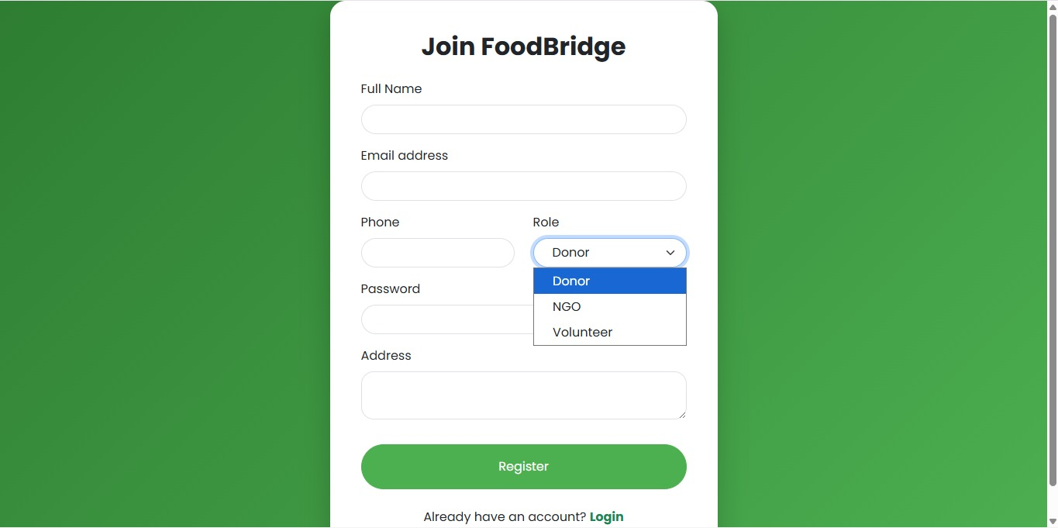
Module-1 Result

Slide 10
Module 2: Food Donation Management
Enables donors to add, update, and manage food donation details through the web portal.
Records important information such as food type, quantity, expiry time, pickup location, and images.
Stores all donation data securely in the cloud for easy accessibility and management.
Allows donors to track the current status of their food donations.
Reduces food wastage by making available food visible to nearby NGOs in real time.

Slide 11
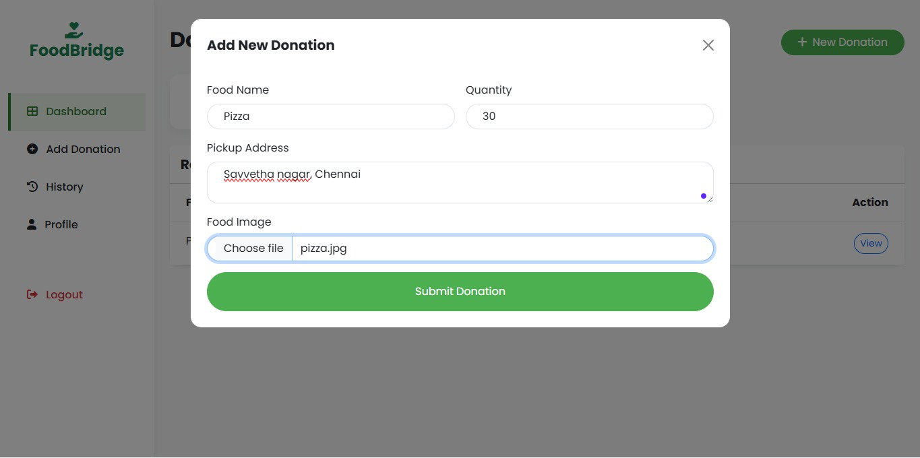
Module-2 Result

Slide 12
Module 3: Food Distribution & Delivery
Allows NGOs to view and accept available food donations based on location and availability.
Assigns volunteers to collect food from donors and deliver it to the required destination.
Provides real-time tracking of pickup and delivery status throughout the process.
Sends notifications and status updates to donors, NGOs, and volunteers.
Ensures timely and efficient food distribution while minimizing delays and food spoilage.

Slide 13
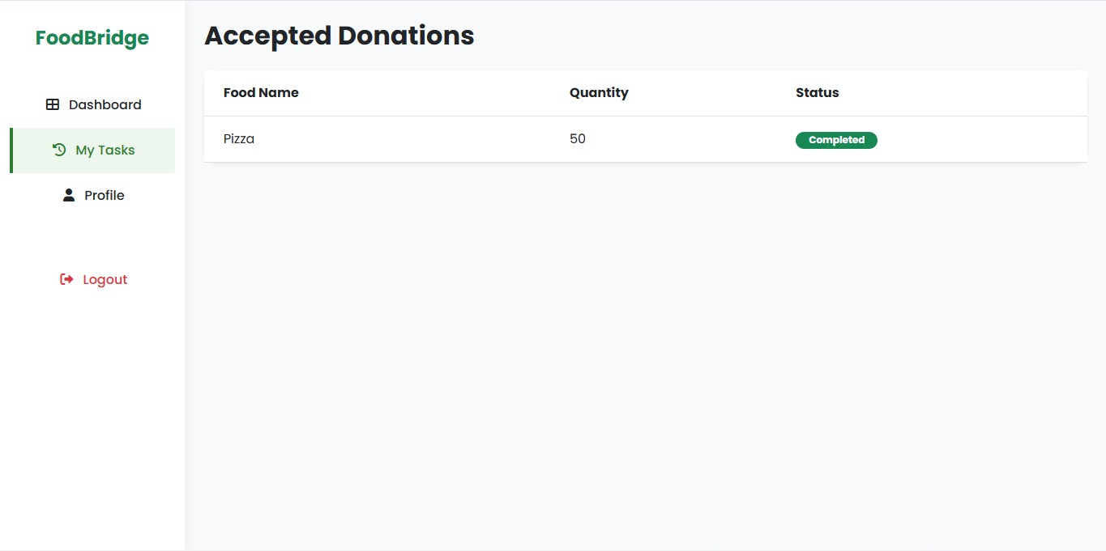
Module-3 Result

Slide 14
Module 4: Administration & Analytics
Provides an administrative dashboard to monitor all users, donations, and delivery activities.
Generates reports on successful, pending, and expired food donations.
Displays analytical dashboards showing donation statistics and system performance.
Manages user accounts, NGO records, volunteer details, and platform settings.
Supports data-driven decision-making through cloud-based reporting and monitoring.

Slide 15
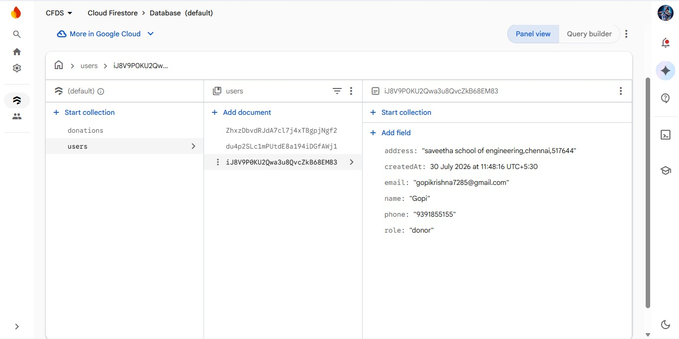
Module-4 Result

Slide 16
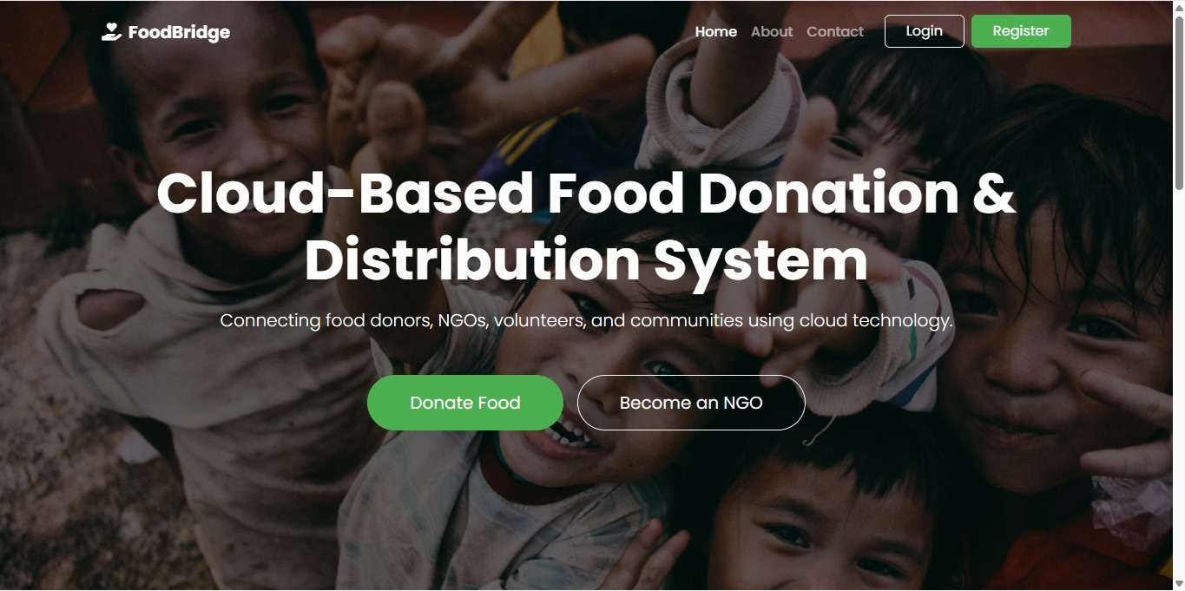
Final Result

Slide 17
Conclusion
The Cloud-Based Food Donation & Distribution System provides an efficient and centralized platform that connects food donors, NGOs, volunteers, and administrators.
The project leverages cloud computing technologies to ensure secure data storage, real-time accessibility, scalability, and reliable system performance.
By automating the food donation and distribution process, the system helps minimize food wastage and ensures the timely delivery of food to people in need.
The system demonstrates the practical application of cloud computing concepts while contributing to social welfare by helping reduce hunger.

Slide 18
Future Scope
Artificial Intelligence (AI): Implement AI-based smart matching to automatically recommend the nearest NGO based on location, food quantity, and expiry time.
Mobile Application: Develop Android and iOS applications for easier access by donors, NGOs, volunteers, and administrators.
IoT Integration: Use IoT sensors to monitor food temperature and quality during transportation to ensure food safety.
Big Data Analytics: Analyze donation patterns, food demand, and volunteer performance to improve planning and resource utilization.

Slide 19
REFERENCES
Z. R. Shi, Y. Yuan, K. Lo, L. Lizarondo, and F. Fang, “Improving Efficiency of Volunteer-Based Food Rescue Operations,” Proceedings of the AAAI Conference on Artificial Intelligence, vol. 34, no. 08, pp. 13369–13375, 2020.
Z. R. Shi, Z. S. Wu, R. Ghani, and F. Fang, “Bandit Data-Driven Optimization for Crowdsourcing Food Rescue Platforms,” Proceedings of the AAAI Conference on Artificial Intelligence, vol. 36, no. 11, 2022. DOI: 10.1609/aaai.v36i11.21475.
C. Phillips, R. Hoenigman, and B. Higbee, “Food Redistribution as Optimization,” 2011. The study examines food rescue and redistribution, focusing on food expiration, transportation, supply, and participation of donors.

Slide 20


